Slide 1

Airline Database
By Kushal Ahuja
Student ID- 14191922

Slide 2
The airline database is inspired by real world airline company i.e. Qantas Airlines. The database contains a set of 8 entities (tables) which are as follows: 1. Booking: It contains information regarding the booking of flight such as ticket fare and booking date. 2. Ticket: It contains information regarding the ticket details. 3. Customer: It contains information regarding the customer who is travelling. It has attributes such as customer name, contact, passport, citizenship, email etc. 4. Baggage: It contains information regarding the baggage details such as quantity. 5. Boarding Pass: It contains information regarding the boarding pass such as origin, destination, boarding date and gate etc. 6. Flight: It contains information regarding the flight such as departure, arrival, flight duration etc. 7. Airplane: It contains information regarding the airplane details such as model name and number. 8. Seats: It contains information regarding the seat details such as seat number and type (business, economy, first class) .
Airline Database: Inspired by Qantas Airlines

Slide 3
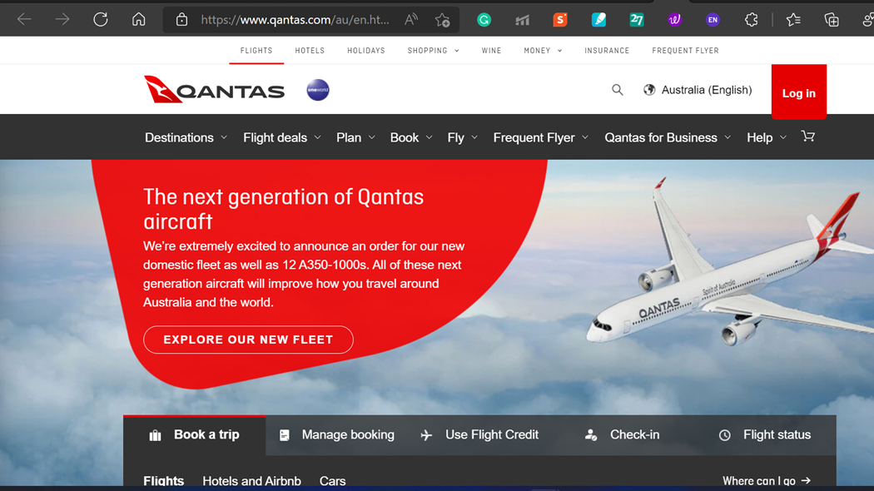

Slide 4
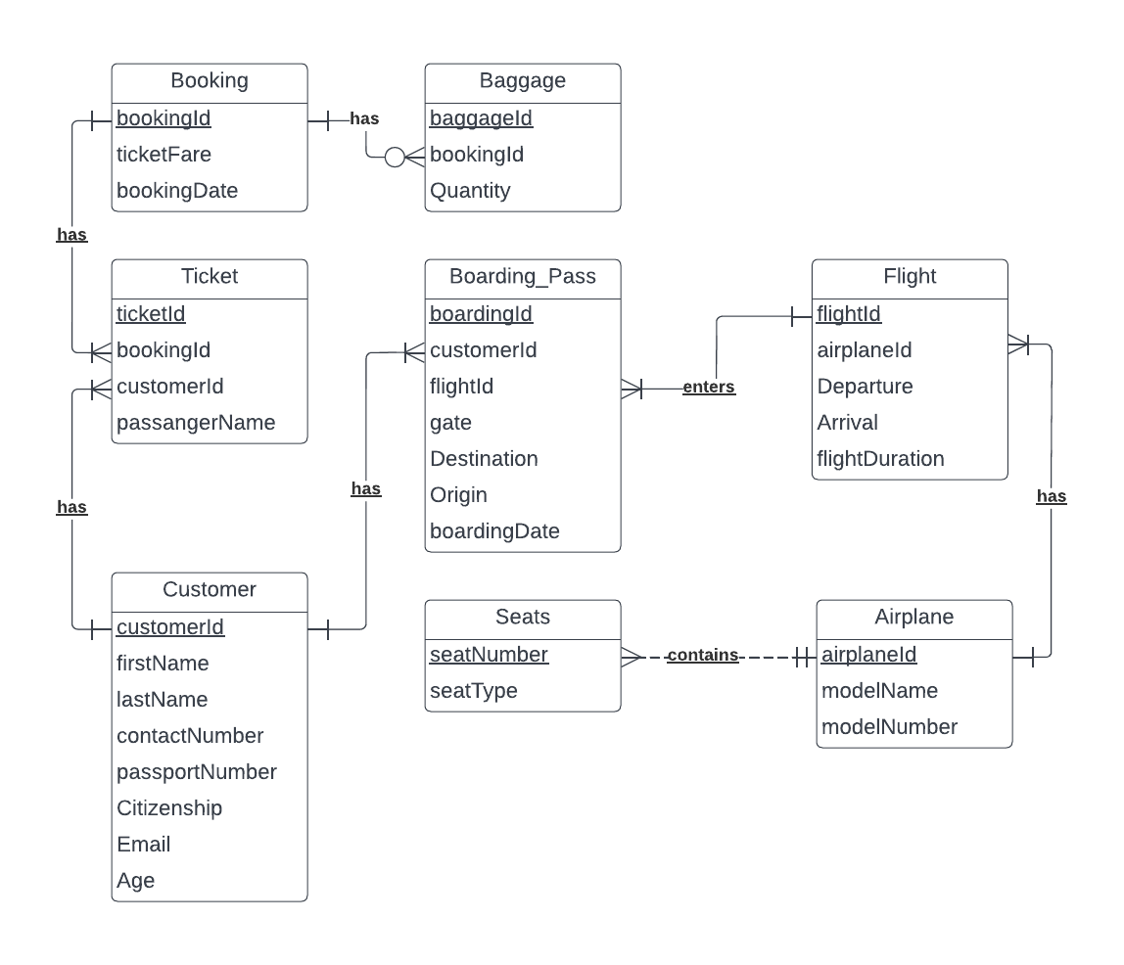
Entity Relationship Diagram (ERD) of Airline Database

Slide 5
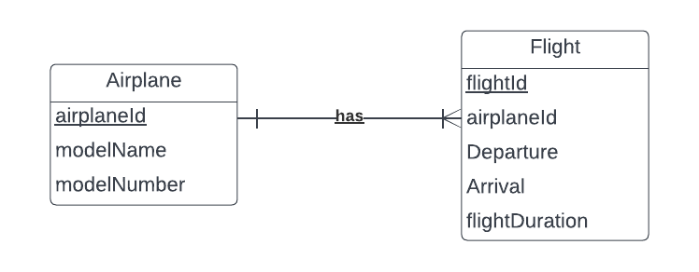
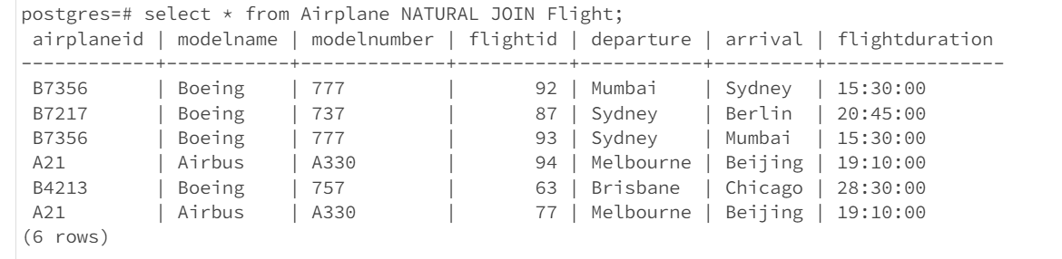
One to Many Relationship The relationship between the entities airplane and flight is one to many relationship as depicted by the below ERD diagram. It implies that one airplane can have one or many flights associated with it.
Realisation of the above relationship in tables:

Slide 6
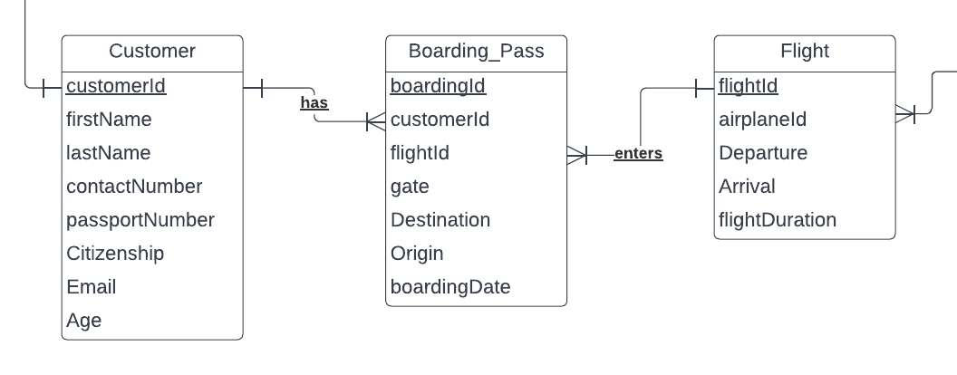
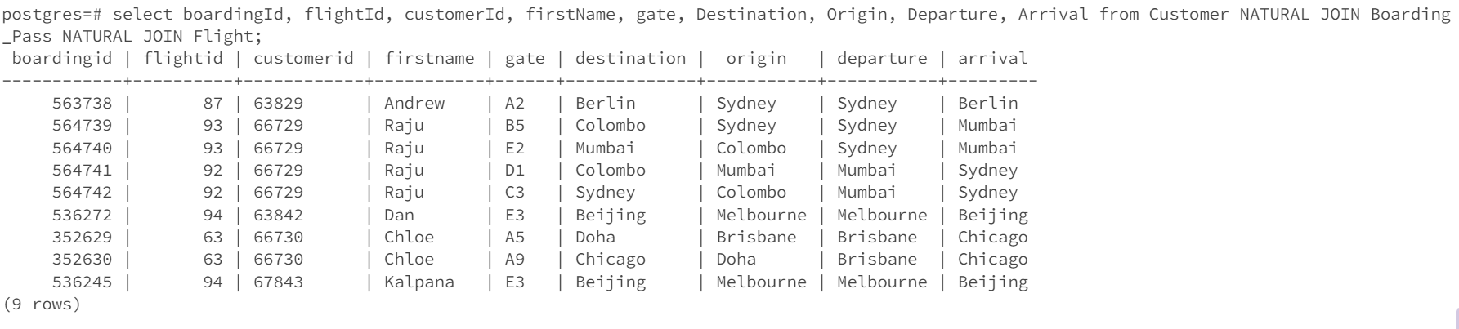
Many to Many Relationship The relationship between the entities customer and flight is a many to many relationship as depicted by the below ERD diagram. It implies that many customers can travel through many flights. The many to many relationship creates problems in the database as they are inefficient. Therefore, this many to many relationship is divided into two one to many relationships by adding an associative entity (bridging table) such as boarding pass in the below ERD diagram.
Realisation of the above relationship in tables:

Slide 7
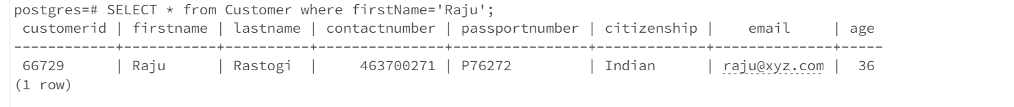
Query 1: Description: To retrieve the customer details of a customer whose first name is Raju. Query: SELECT * from Customer where firstName='Raju';

Slide 8
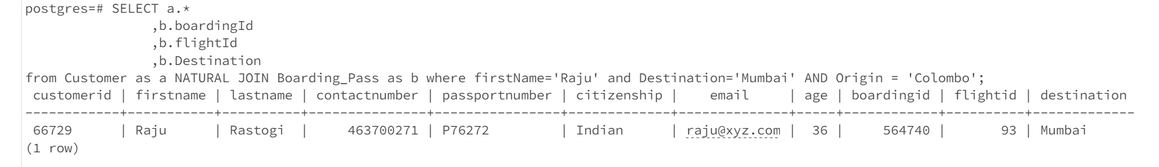
Query 2: Description: To retrieve the boarding pass details of the customer whose first name is Raju and is boarding to Mumbai. Query: SELECT a.* ,b.boardingId ,b.flightId ,b.Destination from Customer as a NATURAL JOIN Boarding_Pass as b where firstName='Raju' and Destination='Mumbai' AND Origin = 'Colombo';

Slide 9
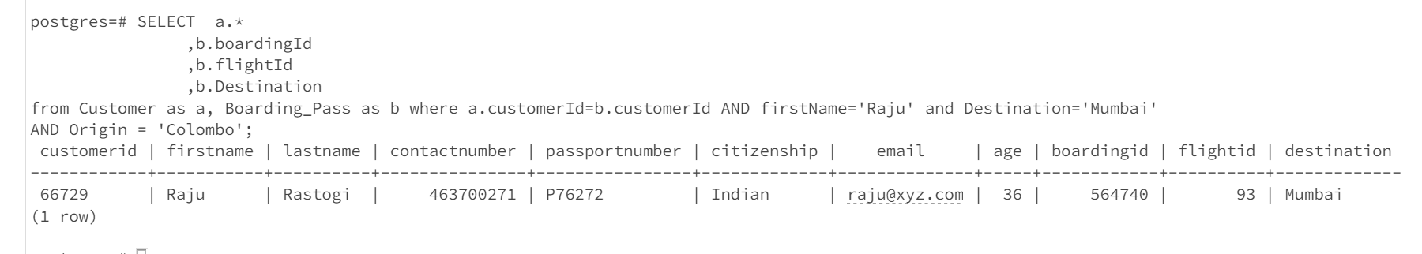
Query 3: Description: To retrieve the boarding pass details of the customer whose first name is Raju and is boarding to Mumbai. Query: SELECT a.* ,b.boardingId ,b.flightId ,b.Destination from Customer as a, Boarding_Pass as b where a.customerId=b.customerId AND firstName='Raju' and Destination='Mumbai’ AND Origin = 'Colombo';

Slide 10
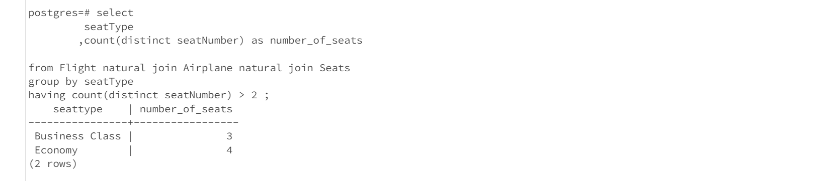
Query 4: Description: To get a list of seat types such as Business class, economy etc which have more than two seats. Query: select seatType,count(distinct seatNumber) as number_of_seats from Flight natural join Airplane natural join Seats group by seatType having count(distinct seatNumber) > 2 ;

Slide 11
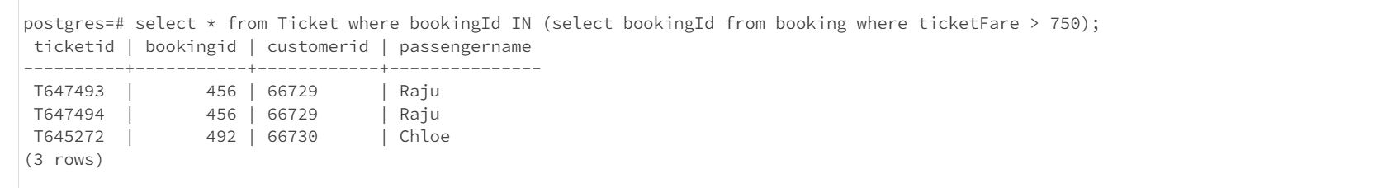
Query 5: Description: To get a list of tickets which have a ticket fare greater than AU $750 Query: select * from Ticket where bookingId IN (select bookingId from booking where ticketFare > 750);

Slide 12
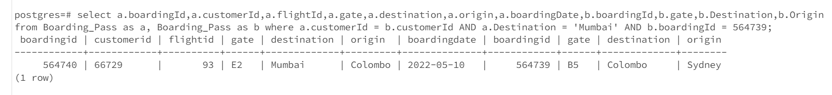
Query 6: Description: To get the flight details of a customer who has travelled from Sydney to Mumbai via Colombo Query: select a.boardingId,a.customerId,a.flightId,a.gate,a.destination,a.origin,a.boardingDate,b.boardingId,b.gate,b.Destination,b.Origin from Boarding_Pass as a, Boarding_Pass as b where a.customerId = b.customerId AND a.Destination = 'Mumbai' AND b.boardingId = 564739;

Slide 13
CHECK Statement Examples used in the Airline Database:
CONSTRAINT di_table_Customer_Age CHECK (Age > 16)
CONSTRAINT di_table_Booking_ticketFare CHECK (ticketFare > 0)

Slide 14
Action Statement Examples used in the Airline Database:
CONSTRAINT Boarding_Pass_fk_Invalid_customerId FOREIGN KEY (customerId) REFERENCES Customer ON DELETE RESTRICT,
CONSTRAINT Boarding_Pass_fk_Invalid_flightId FOREIGN KEY (flightId) REFERENCES Flight ON DELETE CASCADE
CONSTRAINT Ticket_fk_Invalid_bookingId FOREIGN KEY (bookingId) REFERENCES Booking ON DELETE RESTRICT,
CONSTRAINT Ticket_fk_Invalid_customerId FOREIGN KEY (customerId) REFERENCES Customer ON DELETE CASCADE

Slide 15
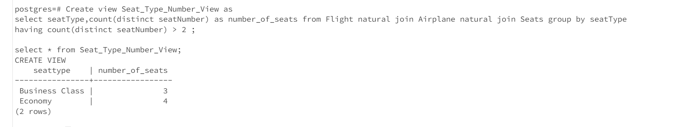
Use of View Description: To get a list of seat types such as Business class, economy etc which have more than two seats. Query: Create view Seat_Type_Number_View as select seatType,count(distinct seatNumber) as number_of_seats from Flight natural join Airplane natural join Seats group by seatType having count(distinct seatNumber) > 2 ;

